Slide 1
Introduction to Data Warehouse and Crisp-DM

Slide 2
DATABASE, DATA WAREHOUSE, DATA MART, DATA SET...?
A database is an organized grouping of information within a specific structure. Most databases in use today are relational databases—they are designed using many tables which relate to one another in a logical fashion. Relational databases generally contain dozens or even hundreds of tables, depending upon the size of the organization.

Slide 3
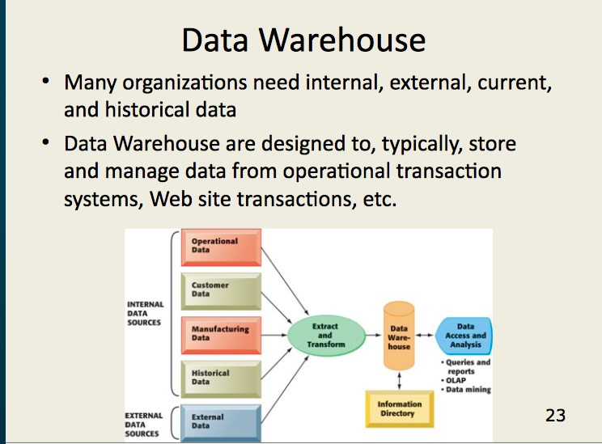

Slide 4
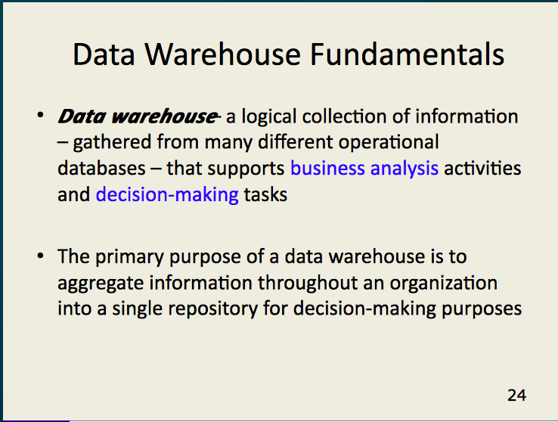

Slide 5
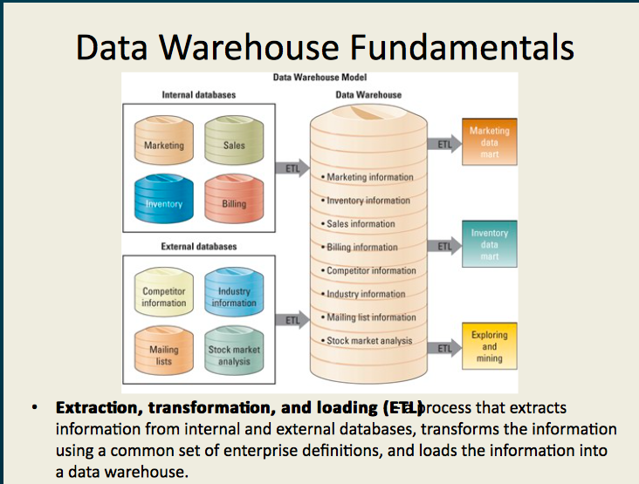

Slide 6
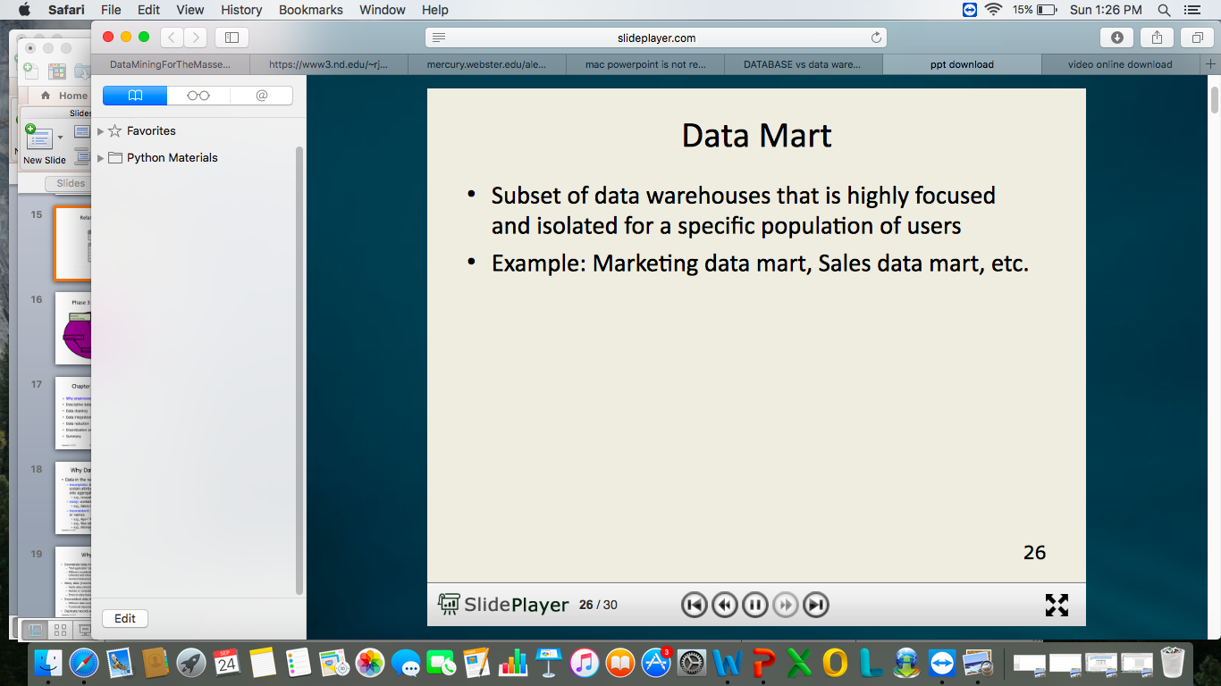

Slide 7
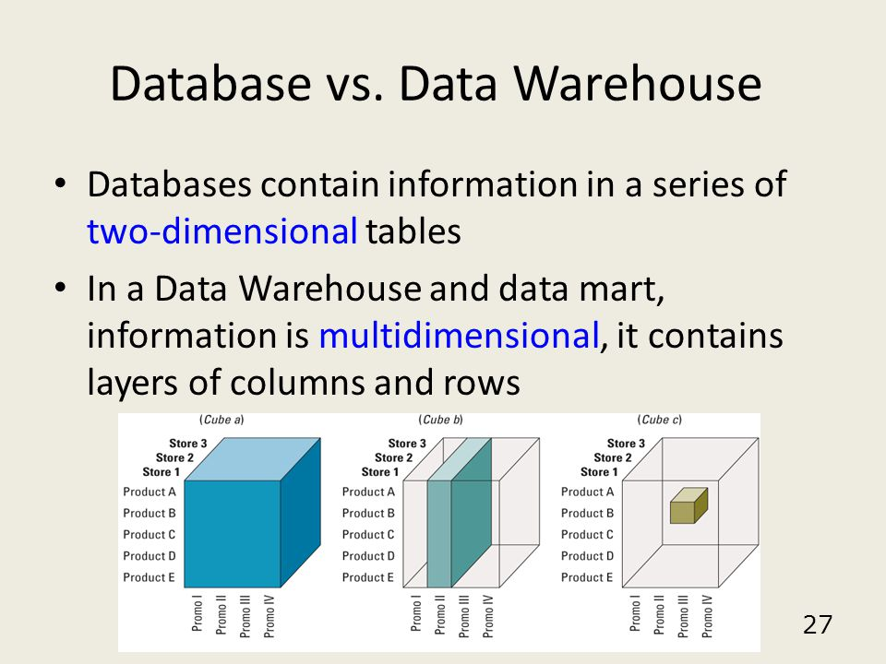

Slide 8
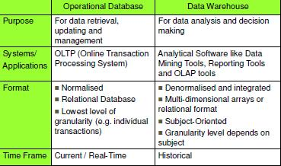

Slide 9
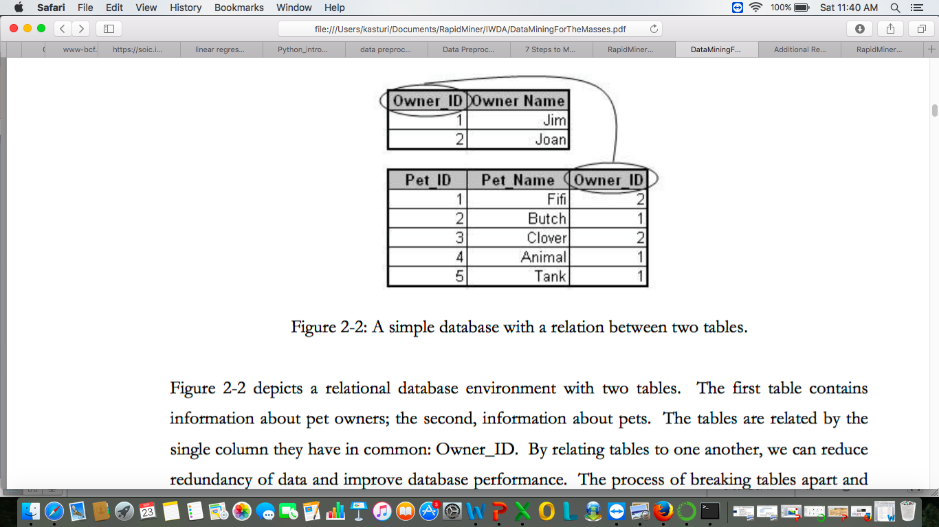
Relational Database

Slide 10
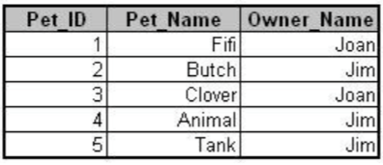
Denormalization

Slide 11
Dataset
A data set is a subset of a database or a data warehouse. It is usually denormalized so that only one table is used. The creation of a data set may contain several steps, including appending or combining tables from source database tables, or simplifying some data expressions.
Data sets may be made up of a representative sample of a larger set of data, or they may contain all observations relevant to a specific group.

Slide 12
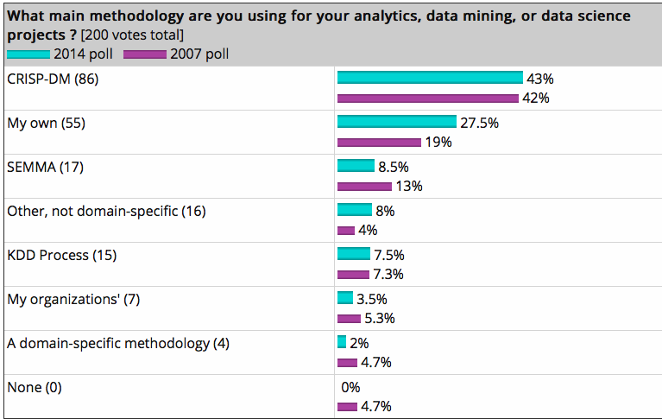

Slide 13
CRISP-DM
CRoss-Industry Standard Process
for Data Mining

Slide 14
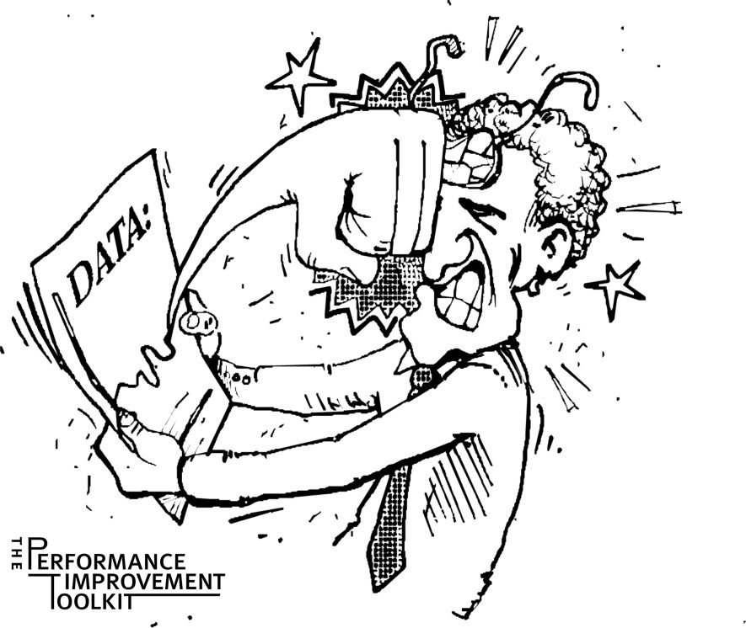
Why Should There be a Standard Process?
The data mining process must be reliable and repeatable by people with little data mining background.

Slide 15
Process Standardization
Initiative launched in late 1996 by three “veterans” of data mining market.
Daimler Chrysler (then Daimler-Benz), SPSS (then ISL) , NCR
Developed and refined through series of workshops (from 1997-1999)
Over 300 organization contributed to the process model
Published CRISP-DM 1.0 (1999)
Over 200 members of the CRISP-DM SIG worldwide
- DM Vendors - SPSS, NCR, IBM, SAS, SGI, Data Distilleries, Syllogic, etc.
- System Suppliers / consultants - Cap Gemini, ICL Retail, Deloitte & Touche, etc.
- End Users - BT, ABB, Lloyds Bank, AirTouch, Experian, etc.

Slide 16

CRISP-DM
Non-proprietary
Application/Industry neutral
Tool neutral
Focus on business issues
As well as technical analysis
Framework for guidance
Experience base
Templates for Analysis

Slide 17

CRISP-DM
Notes:
CRISP-DM- Cross Industry Standard Process for Data Mining

Slide 18
Why CRISP-DM?
The data mining process must be reliable and repeatable by people with little data mining skills
CRISP-DM provides a uniform framework for
guidelines
experience documentation
Aid to project planning and management “Comfort factor” for new adopters
Demonstrates maturity of Data Mining
Reduces dependency on “stars”
Source:- State University of New York & UC Berkerly School of Information

Slide 19
CRISP-DM
Non-proprietary
Application/Industry neutral
Tool neutral
Focus on business issues
As well as technical analysis
Framework for guidance
Experience base
Templates for Analysis
Source:- State University of New York

Slide 20
Phases and Tasks
Business
Understanding
Data
Understanding
Data
Preparation
Modeling
Evaluation
Deployment
Determine
Business Objectives
Background
Business Objectives
Business Success
Criteria
Situation Assessment
Inventory of Resources
Requirements,
Assumptions, and
Constraints
Risks and Contingencies
Terminology
Costs and Benefits
Determine
Data Mining Goal
Data Mining Goals
Data Mining Success
Criteria
Produce Project Plan
Project Plan Initial Asessment of Tools and Techniques
Collect Initial Data
Initial Data Collection
Report
Describe Data
Data Description Report
Explore Data
Data Exploration Report Verify Data Quality
Data Quality Report
Data Set
Data Set Description
Select Data
Rationale for Inclusion /
Exclusion
Clean Data
Data Cleaning Report
Construct Data
Derived Attributes
Generated Records
Integrate Data
Merged Data
Format Data
Reformatted Data
Select Modeling
Technique
Modeling Technique
Modeling Assumptions
Generate Test Design
Test Design
Build Model
Parameter Settings
Models
Model Description
Assess Model
Model Assessment Revised Parameter Settings
Evaluate Results
Assessment of Data
Mining Results w.r.t.
Business Success
Criteria
Approved Models
Review Process
Review of Process
Determine Next Steps
List of Possible Actions
Decision
Plan Deployment
Deployment Plan
Plan Monitoring and
Maintenance
Monitoring and Maintenance Plan
Produce Final Report
Final Report
Final Presentation
Review Project
Experience
Documentation

Slide 21
Phase 1:- Business Understanding
TASKS
Business objective
Assess situation
Data mining goals
Project plan
Business understanding
Data understanding
Data
Preparation
Deployment
Modeling
Evaluation

Slide 22
Phase 1:- Business Understanding
Determine business objectives
- thoroughly understand, from a business perspective, what the client really wants to accomplish
- uncover important factors, at the beginning, that can influence the outcome of the project
- neglecting this step is to expend a great deal of effort producing the right answers to the wrong questions
Assess situation
- more detailed fact-finding about all of the resources, constraints, assumptions and other factors that should be considered
- flesh out the details

Slide 23
Phase 1:- Business Understanding
Determine data mining goals
- a business goal states objectives in business terminology
- a data mining goal states project objectives in technical terms
ex:-
the business goal: “Increase catalog sales to existing customers.”
a data mining goal: “Predict how many widgets a customer will buy, given their purchases over the past three years, demographic information (age, salary, city) and the price of the item.”
Produce project plan
- describe the intended plan for achieving the data mining goals and the business goals
- the plan should specify the anticipated set of steps to be performed during the rest of the project including an initial selection of tools and techniques
Notes:
To determine goals:-
Identify Business goal for our dataset- customer data
Identify data mining goal for Customer data
Produce Project Plan
-

Slide 24
Phase 2:- Data Understanding
TASKS
Collect data
Describe data
Explore data
Verify data quality
Business understanding
Data understanding
Data
Preparation
Deployment
Modeling
Evaluation

Slide 25
Phase 2:- Data Understanding
Explore the data
Verify the quality
Find Outliers
Starts with an initial data collection and proceeds with activities in order to get familiar with the data, to identify data quality problems, to discover first insights into the data or to detect interesting subsets to form hypotheses for hidden information.
Notes:
The data understanding phase of CRISP-DM involves taking a closer look at the data available for mining. ... Data understanding involves accessing the data and exploring it using tables and graphics
Starts with an initial data collection and proceeds with activities in order to get familiar with the data, to identify data quality problems, to discover first insights into the data or to detect interesting subsets to form hypotheses for hidden information.

Slide 26
Phase 2. Data Understanding
Collect initial data
- acquire within the project the data listed in the project resources
- includes data loading if necessary for data understanding
- possibly leads to initial data preparation steps
- if acquiring multiple data sources, integration is an additional issue, either here or in the later data preparation phase
Describe data
- examine the “gross” or “surface” properties of the acquired data
- report on the results

Slide 27
Phase 2. Data Understanding
Explore data
- tackles the data mining questions, which can be addressed using querying, visualization and reporting including:
distribution of key attributes, results of simple aggregations
relations between pairs or small numbers of attributes
properties of significant sub-populations, simple statistical analyses
- may address directly the data mining goals
- may contribute to or refine the data description and quality reports
- may feed into the transformation and other data preparation needed
Verify data quality
- examine the quality of the data, addressing questions such as:
“Is the data complete?”, Are there missing values in the data?”

Slide 28
Phase 3:- Data Preparation
TASKS
Select data
Clean data
Construct data
Integrate data
Format data
Business understanding
Data understanding
Data
Preparation
Deployment
Modeling
Evaluation
Notes:
Takes usually over 90% of the time
- Collection
- Assessment
- Consolidation and Cleaning
- Data selection
- Transformations
Covers all activities to construct the final dataset from the initial raw data. Data preparation tasks are likely to be performed multiple times and not in any prescribed order. Tasks include table, record and attribute selection as well as transformation and cleaning of data for modeling tools.

Slide 29
Phase 3. Data Preparation
Takes usually over 90% of the time
- Collection
- Assessment
- Consolidation and Cleaning
- Data selection
- Transformations
Covers all activities to construct the final dataset from the initial raw data. Data preparation tasks are likely to be performed multiple times and not in any prescribed order. Tasks include table, record and attribute selection as well as transformation and cleaning of data for modeling tools.

Slide 30
Data Preparation
Select data
- decide on the data to be used for analysis
- criteria include relevance to the data mining goals, quality and technical constraints such as limits on data volume or data types
- covers selection of attributes as well as selection of records in a table

Slide 31
Data Preparation
Clean data
- raise the data quality to the level required by the selected analysis techniques
- may involve selection of clean subsets of the data, the insertion of suitable defaults or more ambitious techniques such as the estimation of missing data by modeling

Slide 32
Data Preparation
Construct data
- constructive data preparation operations such as the production of derived attributes, entire new records or transformed values for existing attributes
Integrate data
- methods whereby information is combined from multiple tables or records to create new records or values
Format data
- formatting transformations refer to primarily syntactic modifications made to the data that do not change its meaning, but might be required by the modeling tool

Slide 33
Phase 4:- Modelling
TASKS
Select modeling
techniques
Design the test
Build model
Assess model
Business understanding
Data understanding
Data
Preparation
Deployment
Modeling
Evaluation
Notes:
Select the modeling technique
(based upon the data mining objective)
Build model
(Parameter settings)
Assess model (rank the models)
Various modeling techniques are selected and applied and their parameters are calibrated to optimal values. Some techniques have specific requirements on the form of data. Therefore, stepping back to the data preparation phase is often necessary.
Select modeling technique
- select the actual modeling technique that is to be used
ex) decision tree, neural network
- if multiple techniques are applied, perform this task for each techniques separately
Generate test design
- before actually building a model, generate a procedure or mechanism to test the model’s quality and validity
ex) In classification, it is common to use error rates as quality measures for data mining models. Therefore, typically separate the dataset into train and test set, build the model on the train set and estimate its quality on the separate test set
Build model
- run the modeling tool on the prepared dataset to create one or more models
Assess model
- interprets the models according to his domain knowledge, the data mining success criteria and the desired test design
- judges the success of the application of modeling and discovery techniques more technically
- contacts business analysts and domain experts later in order to discuss the data mining results in the business context
- only consider models whereas the evaluation phase also takes into account all other results that were produced in the course of the project

Slide 34
Phase 4. Modeling
Select the modeling technique
(based upon the data mining objective)
Build model
(Parameter settings)
Assess model (rank the models)
Various modeling techniques are selected and applied and their parameters are calibrated to optimal values. Some techniques have specific requirements on the form of data. Therefore, stepping back to the data preparation phase is often necessary.

Slide 35
Phase 4. Modeling
Select modeling technique
- select the actual modeling technique that is to be used
ex) decision tree, neural network
- if multiple techniques are applied, perform this task for each techniques separately
Generate test design
- before actually building a model, generate a procedure or mechanism to test the model’s quality and validity
ex) In classification, it is common to use error rates as quality measures for data mining models. Therefore, typically separate the dataset into train and test set, build the model on the train set and estimate its quality on the separate test set

Slide 36
Phase 4. Modeling
Build model
- run the modeling tool on the prepared dataset to create one or more models
Assess model
- interprets the models according to his domain knowledge, the data mining success criteria and the desired test design
- judges the success of the application of modeling and discovery techniques more technically
- contacts business analysts and domain experts later in order to discuss the data mining results in the business context
- only consider models whereas the evaluation phase also takes into account all other results that were produced in the course of the project

Slide 37
Phase 5:- Evaluation
TASKS
Evaluate results
Review process
Determine next
steps
Business understanding
Data understanding
Data
Preparation
Deployment
Modeling
Evaluation
Notes:
Evaluation of model
- how well it performed on test data
Methods and criteria
- depend on model type
Interpretation of model
- important or not, easy or hard depends on algorithm
Thoroughly evaluate the model and review the steps executed to construct the model to be certain it properly achieves the business objectives. A key objective is to determine if there is some important business issue that has not been sufficiently considered. At the end of this phase, a decision on the use of the data mining results should be reached
Evaluate results
- assesses the degree to which the model meets the business objectives
- seeks to determine if there is some business reason why this model is deficient
- test the model(s) on test applications in the real application if time and budget constraints permit
- also assesses other data mining results generated
- unveil additional challenges, information or hints for future directions
Review process
- do a more thorough review of the data mining engagement in order to determine if there is any important factor or task that has somehow been overlooked
- review the quality assurance issues
ex) “Did we correctly build the model?”
Determine next steps
- decides how to proceed at this stage
- decides whether to finish the project and move on to deployment if appropriate or whether to initiate further iterations or set up new data mining projects
- include analyses of remaining resources and budget that influences the decisions

Slide 38
Phase 5. Evaluation
Evaluation of model
- how well it performed on test data
Methods and criteria
- depend on model type
Interpretation of model
- important or not, easy or hard depends on algorithm
Thoroughly evaluate the model and review the steps executed to construct the model to be certain it properly achieves the business objectives. A key objective is to determine if there is some important business issue that has not been sufficiently considered. At the end of this phase, a decision on the use of the data mining results should be reached

Slide 39
Phase 5. Evaluation
Evaluate results
- assesses the degree to which the model meets the business objectives
- seeks to determine if there is some business reason why this model is deficient
- test the model(s) on test applications in the real application if time and budget constraints permit
- also assesses other data mining results generated
- unveil additional challenges, information or hints for future directions

Slide 40
Phase 5. Evaluation
Review process
- do a more thorough review of the data mining engagement in order to determine if there is any important factor or task that has somehow been overlooked
- review the quality assurance issues
ex) “Did we correctly build the model?”
Determine next steps
- decides how to proceed at this stage
- decides whether to finish the project and move on to deployment if appropriate or whether to initiate further iterations or set up new data mining projects
- include analyses of remaining resources and budget that influences the decisions

Slide 41
Phase 6:- Deployment
TASKS
Plan deployment
Plan monitoring
and maintenance
Final report
Review project
Business understanding
Data understanding
Data
Preparation
Deployment
Modeling
Evaluation
Notes:
Determine how the results need to be utilized
Who needs to use them?
How often do they need to be used
Deploy Data Mining results by
Scoring a database, utilizing results as business rules,
interactive scoring on-line
The knowledge gained will need to be organized and presented in a way that the customer can use it. However, depending on the requirements, the deployment phase can be as simple as generating a report or as complex as implementing a repeatable data mining process across the enterprise.
Plan deployment
- in order to deploy the data mining result(s) into the business, takes the evaluation results and concludes a strategy for deployment
- document the procedure for later deployment
Plan monitoring and maintenance
- important if the data mining results become part of the day-to-day business and it environment
- helps to avoid unnecessarily long periods of incorrect usage of data mining results
- needs a detailed on monitoring process
- takes into account the specific type of deployment
Produce final report
- the project leader and his team write up a final report
- may be only a summary of the project and its experiences
- may be a final and comprehensive presentation of the data mining result(s)
Review project
- assess what went right and what went wrong, what was done well and what needs to be improved

Slide 42
Phase 6. Deployment
Determine how the results need to be utilized
Who needs to use them?
How often do they need to be used
Deploy Data Mining results by
Scoring a database, utilizing results as business rules,
interactive scoring on-line
The knowledge gained will need to be organized and presented in a way that the customer can use it. However, depending on the requirements, the deployment phase can be as simple as generating a report or as complex as implementing a repeatable data mining process across the enterprise.

Slide 43
Phase 6. Deployment
Plan deployment
- in order to deploy the data mining result(s) into the business, takes the evaluation results and concludes a strategy for deployment
- document the procedure for later deployment
Plan monitoring and maintenance
- important if the data mining results become part of the day-to-day business and it environment
- helps to avoid unnecessarily long periods of incorrect usage of data mining results
- needs a detailed on monitoring process
- takes into account the specific type of deployment

Slide 44
Phase 6. Deployment
Produce final report
- the project leader and his team write up a final report
- may be only a summary of the project and its experiences
- may be a final and comprehensive presentation of the data mining result(s)
Review project
- assess what went right and what went wrong, what was done well and what needs to be improved

